Slide 1

Predicting On-Time Delivery Using Machine Learning
A data-driven approach to optimizing logistics performance
Project by: Dennis Irimu
Objective: Build predictive models to forecast shipment delivery outcomes using customer analytics data, enabling proactive risk management and improved operational efficiency.
Approach: Logistic Regression and Decision Tree Classifier models trained on real-world shipping data.

Slide 2

Background & Motivation
Operational Impact
Complexity of Delays
Timely delivery directly impacts customer satisfaction, retention, and brand reputation in an increasingly competitive market.
Multiple factors influence delivery performance—shipment mode, warehouse efficiency, product prioritization, and distance all contribute to outcomes.
Data-Driven Solution
Predictive analytics transforms historical data into actionable intelligence, enabling logistics teams to anticipate and prevent delays before they occur.

Slide 3

Business Objective
1
Classify Delivery Outcomes
2
Enable Proactive Management
3
Improve Reliability
Increase on-time delivery rates through targeted operational improvements and data-backed decision-making across the supply chain.
Predict whether each shipment will arrive on time (1) or experience delays (0) using shipment and product characteristics.
Identify at-risk shipments early, allowing logistics teams to allocate resources strategically and manage customer expectations.

Slide 4

Dataset Overview
Customer Analytics dataset from Kaggle containing comprehensive shipping records and operational metrics.
10,999
9
Total Records
Core Features
Shipment transactions analyzed
Warehouse, shipment mode, product attributes
Key Variables: Warehouse block, shipment mode (Ship/Flight/Road), product importance rating, customer gender, shipment weight, delivery distance, product cost, and binary target: on-time arrival status.

Slide 5
Data Preparation & Processing
01
02
Missing Value Handling
Categorical Encoding
Identified and appropriately treated incomplete records to ensure data quality and model reliability.
Applied One-Hot Encoding to convert categorical variables (warehouse blocks, shipment modes) into numerical format for model compatibility.
03
04
Train-Test Split
Feature Scaling
Divided data using 80/20 ratio to ensure robust model evaluation on unseen data.
Normalized numerical features using standardization to optimize logistic regression performance and convergence.
Result: Clean, balanced dataset ready for model training and validation.

Slide 6
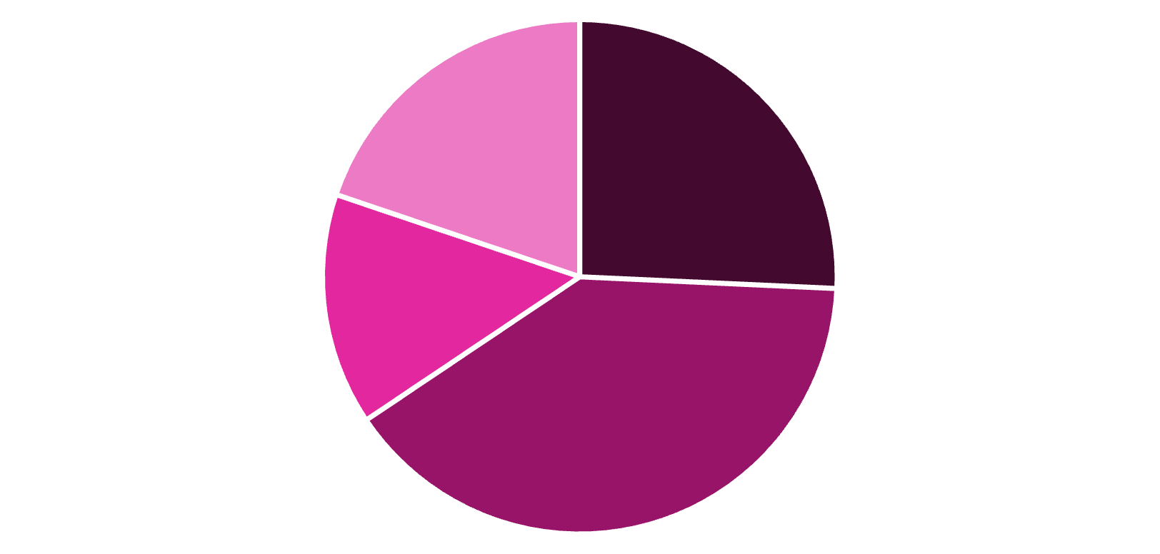
Model 1: Logistic Regression
Baseline Classification Model
Linear model establishes performance baseline, providing interpretable coefficients and fast predictions for real-time deployment scenarios.
Accuracy: 65.6%
True Positives
True Negatives
False Positives
False Negatives
Interpretation: The model captures moderate predictive power but exhibits room for improvement in recall and F1 score, particularly in identifying late deliveries (false negatives).

Slide 7

Model 2: Decision Tree Classifier
Non-Linear Capability
Hyperparameter Tuning
Captures complex interactions and thresholds in delivery data that linear models miss.
GridSearchCV optimization of max_depth and min_samples_split parameters for balanced accuracy and interpretability.
Improved Performance
Achieved better accuracy through tuning, with enhanced ability to identify key decision thresholds influencing on-time delivery.

Slide 8
Model Comparison
Dimension
Logistic Regression
Decision Tree
Complexity
Simple, linear
Flexible, non-linear
Speed
Fast inference
Moderate speed
Interpretability
Coefficients
Rule-based paths
Feature Interactions
Limited
Captures complex patterns
Accuracy
65.6%
Improved via tuning
Selection Criteria: Decision Tree selected based on superior cross-validation performance, explainability for stakeholder communication, and ability to identify actionable operational levers.

Slide 9

Key Insights & Feature Importance
Shipment Mode
Warehouse Block
Product Importance
Air shipments demonstrated significantly higher on-time probability compared to maritime and road options, indicating faster transit with fewer delays.
Specific warehouse locations consistently influenced delivery outcomes. Some blocks exhibited superior processing efficiency and fulfillment speed.
Low-priority products correlated with slower fulfillment times, suggesting resource allocation favors high-value shipments in operational scheduling.

Slide 10

Recommendations & Next Steps
Resource Prioritization
Operational Improvements
Allocate premium logistics resources to critical and high-value product shipments. Establish priority queues and expedited handling protocols.
Conduct detailed analysis of underperforming warehouse blocks. Implement targeted process improvements, staff training, and equipment upgrades to eliminate bottlenecks.
Model Enhancement
Dashboard Integration
Explore ensemble methods like Random Forests and Gradient Boosting to capture additional patterns and further improve prediction accuracy.
Embed model predictions into real-time logistics dashboards. Enable proactive monitoring and early intervention for at-risk shipments.

